Slide 1
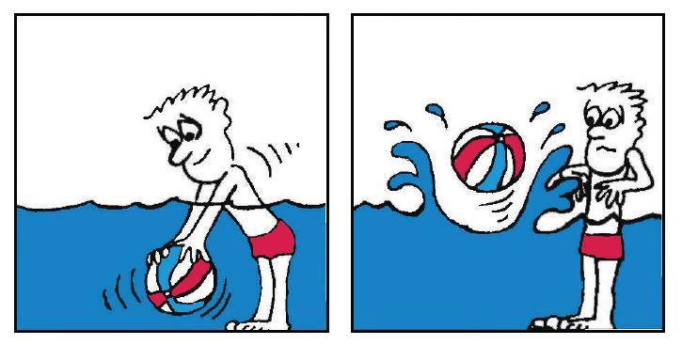
Using 2D-Axisymmetric Finite Element Models to understand the influence of Magma Underplating
Ophelia George
PhD Candidate in Geology
University of South Florida
2015 MDF Mid-Year Research and Writing Conference

Slide 2




Acknowledgement
Research Team
  Co Advisor: Rocco Malservisi, PhD
  Co Advisor: Charles Connor, PhD
  Technical Support: Rob Govers (PhD), Lukas van de Wiel, Laura Connor.
Funding
  Obayashi Corpation (NUMO project)
  McKnight Dissertaion Fellowship (FEF)

Slide 3
Talk Outline
Background
  Study Area/Tectonic Setting
  Motivation
  Model Setup
Models/Results
Model Validation: Comparison with Regional Gravity
Conclusions

Slide 4
Background

Slide 5
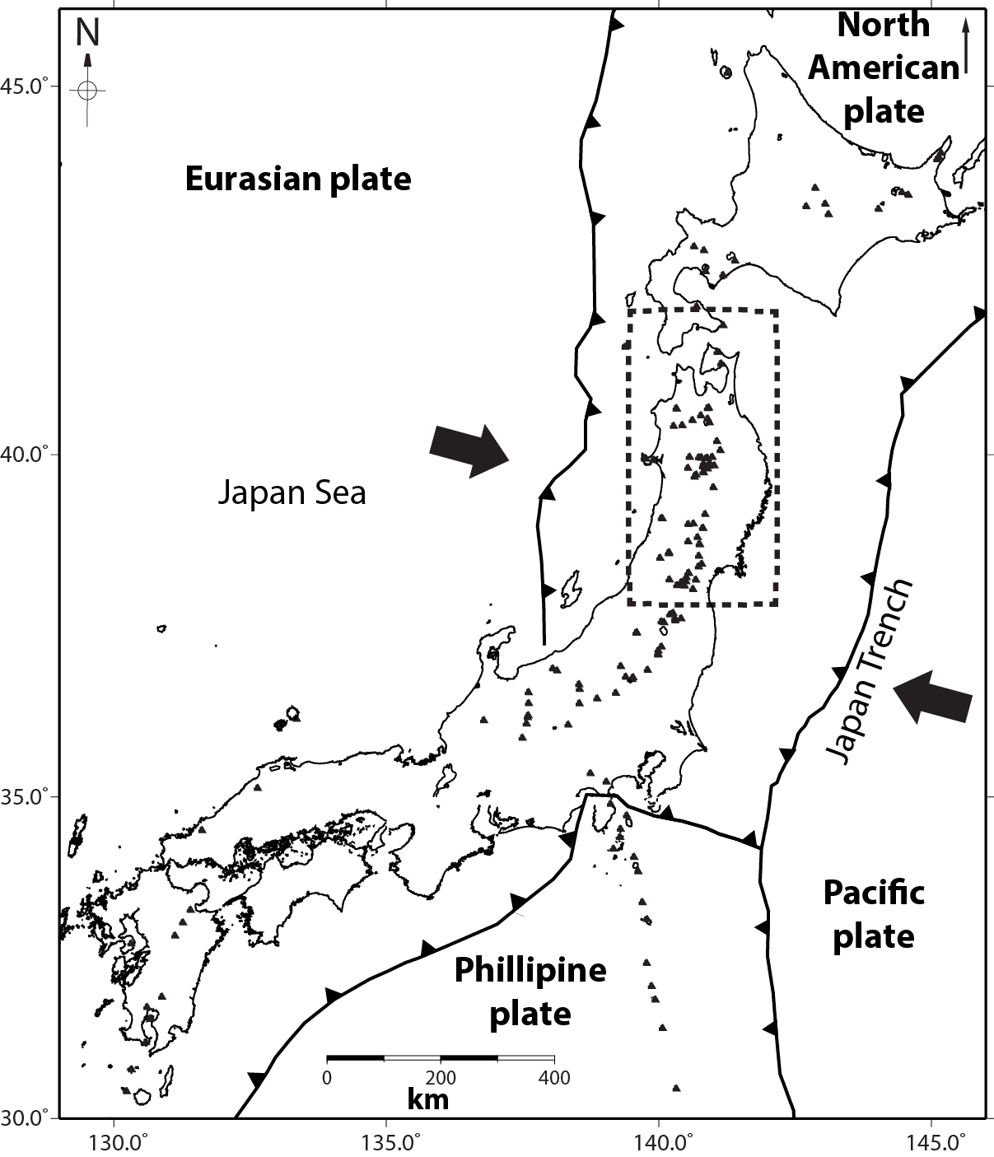
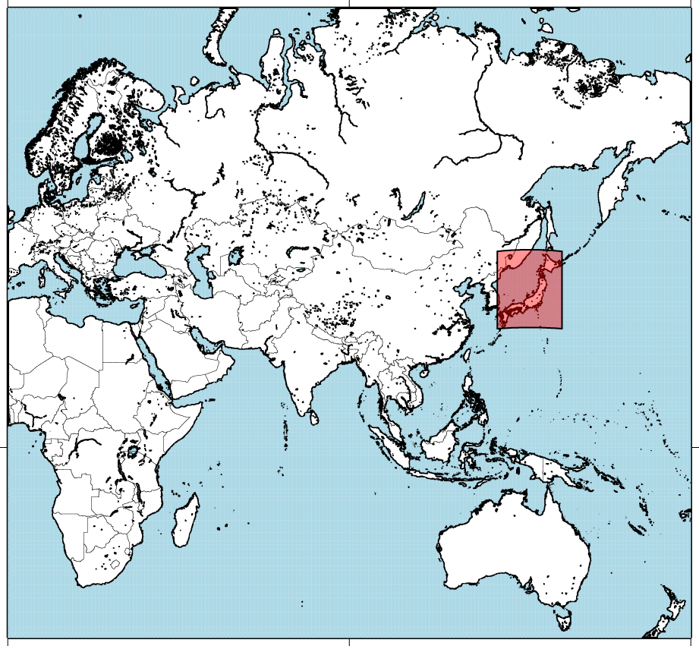
Study Area/Tectonic Setting
Subduction zone created by the collision of 4 tectonic plates
Volcanoes occur in cluster along the arc
Clusters are topographically elevated

Slide 6
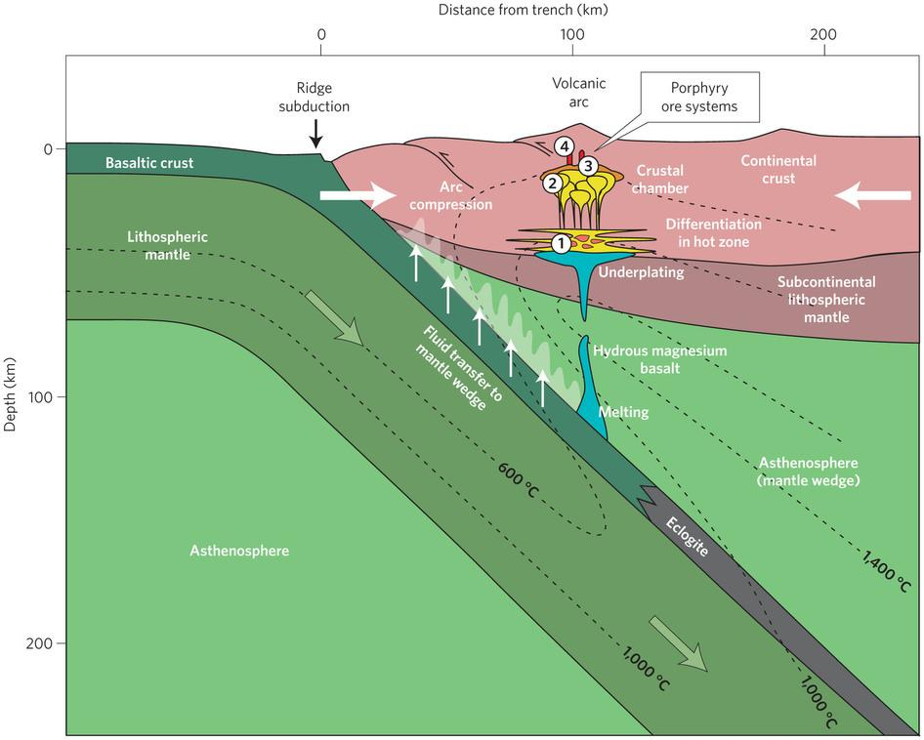
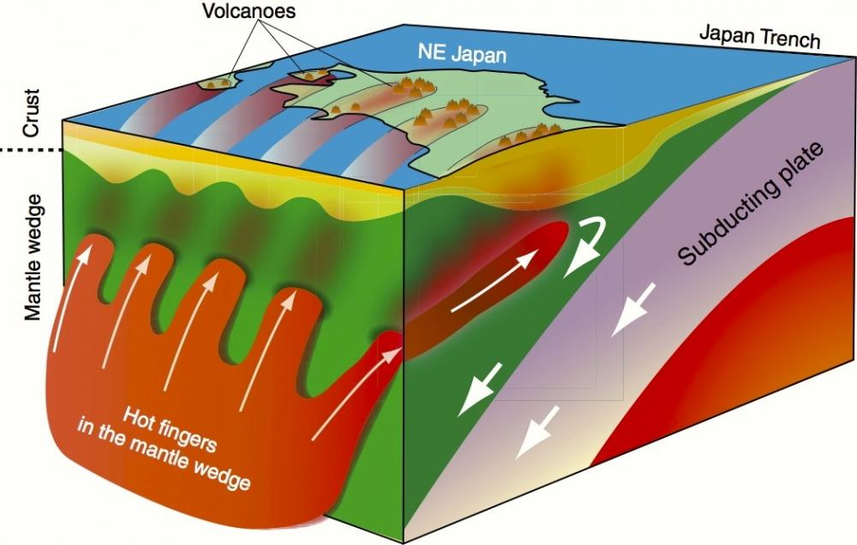
Study Motivation
Many of the volcanic clusters are associated with negative gravity anomalies.
Volcanoes are topographically elevated relative to the surrounding area.
Low velocity seismic zones exist beneath the volcanic arc.
Tamura, Y.,
Wilkinson, Jamie J. (2015)
Plato.is

Slide 7
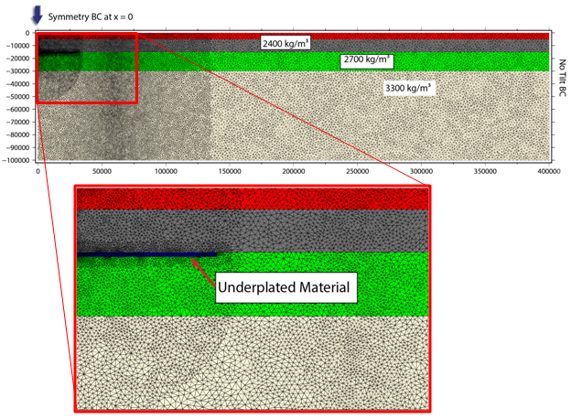
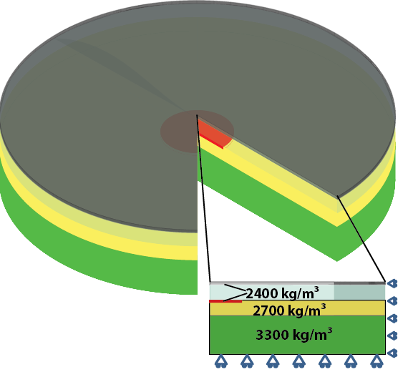
Numerical Method
Model utilize the Finite Element Modeling (FEM) code, GTecton.
All test use 2D-Axisymmetric models.
Domains have a radius of 400 km and are divided into 4 main layers to represent the average Tohoku lithosphere
Intrusions are underplated either at the Conrad or the Moho

Slide 8
Modeled Scenarios
Parameters Tested: Intrusion geometry, intrusion depth, elastic layer thickness, rheology

Slide 9
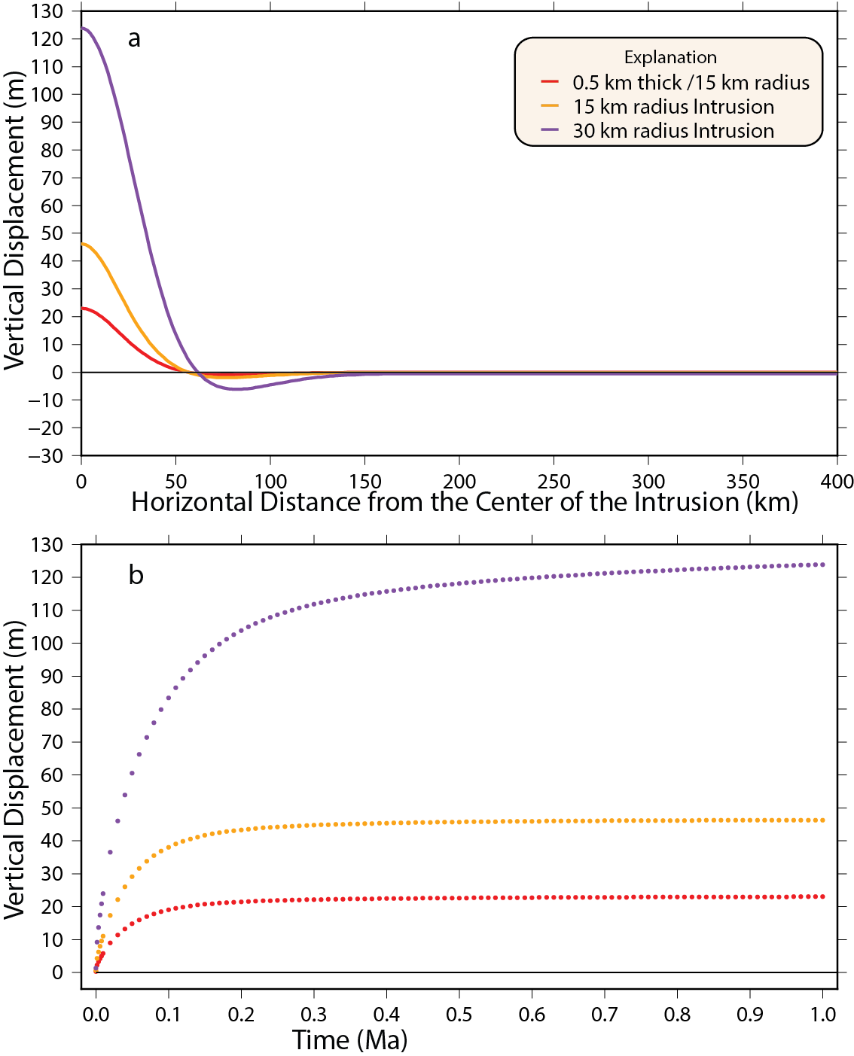
Varying Intrusion geometry
Size of volcanic cluster indicate that radial bodies of 15-30 km could underlie the clusters.
Models monitor the deformation of the surface 1 Myr after the initial intrusion.
All bodies shown here are underplated at the Conrad discontinuity.
Deformation at x=y=z=0

Slide 10
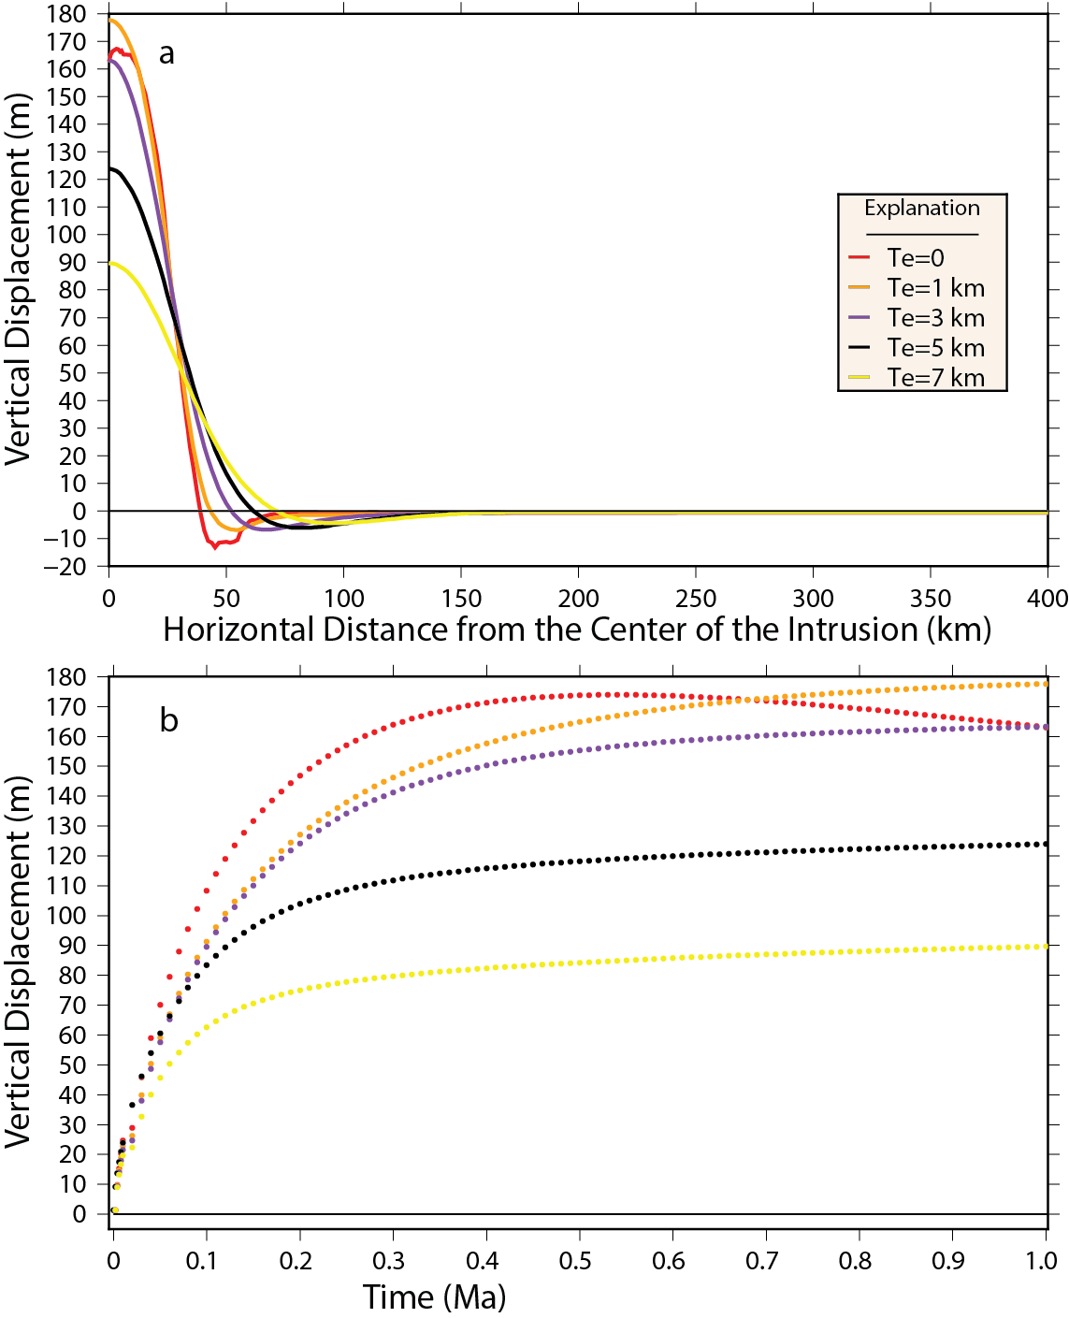
Elastic Layer Thickness
In thin beam theory, the flexure of the bending beam is controlled by the thickness of the elastic layer.
Models are tested with elastic layer thicknesses of 0, 1, 3, 5 and 7 km.
Values are low for a typical tectonic setting but plausible for a volcanic arc.

Slide 11
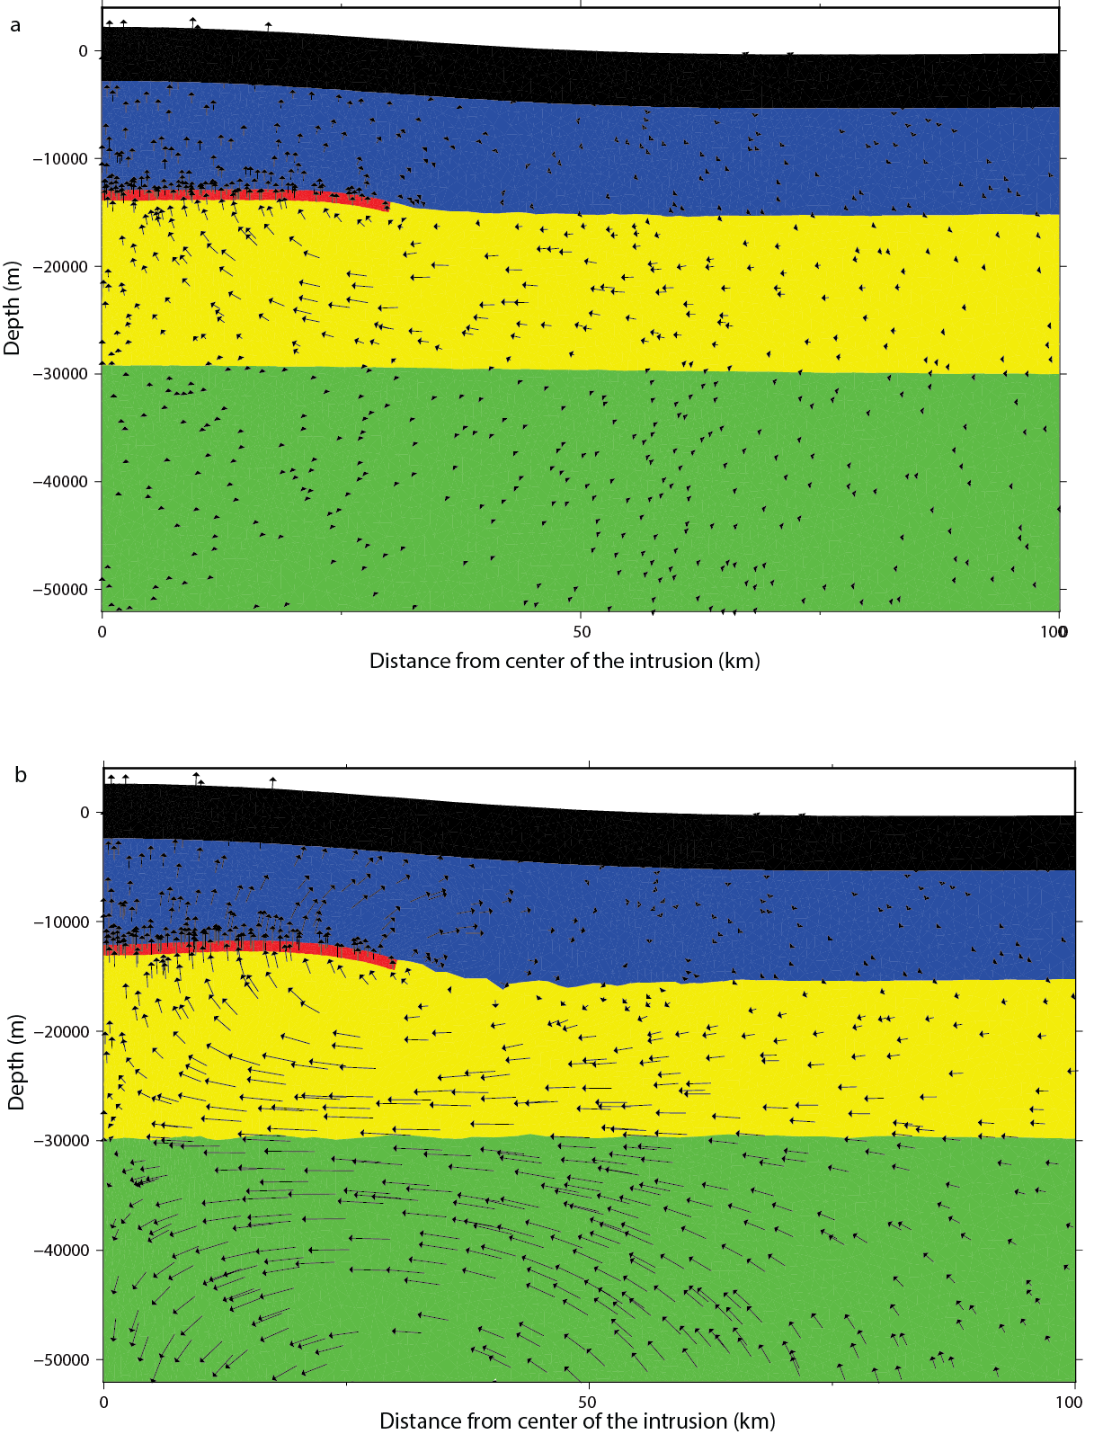
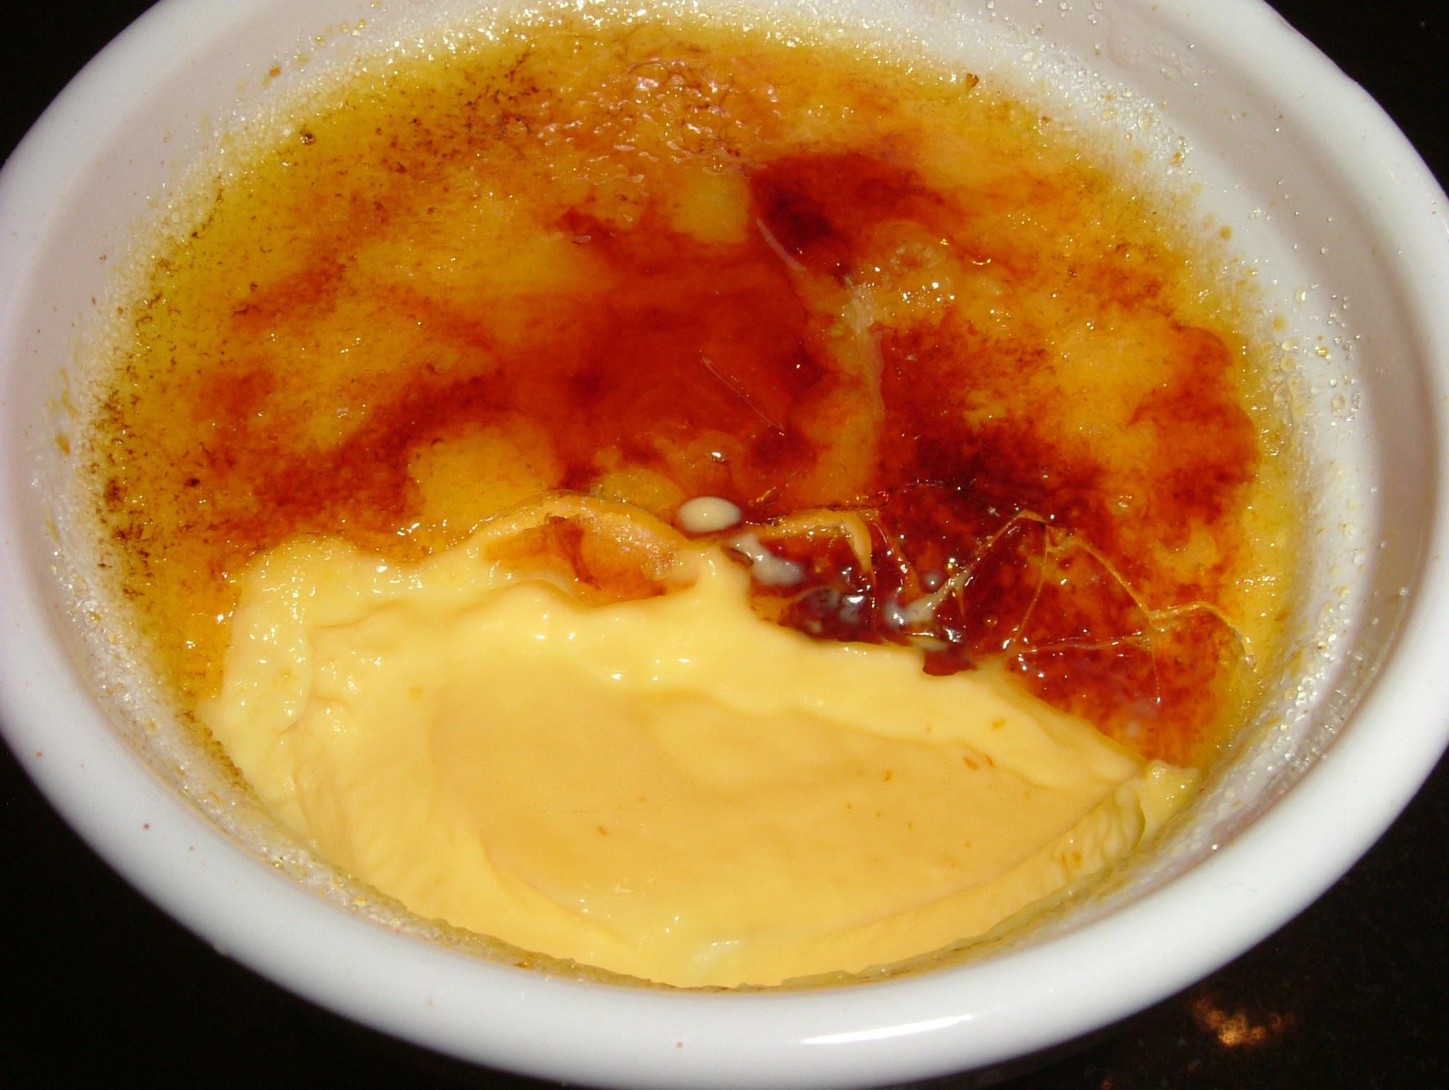
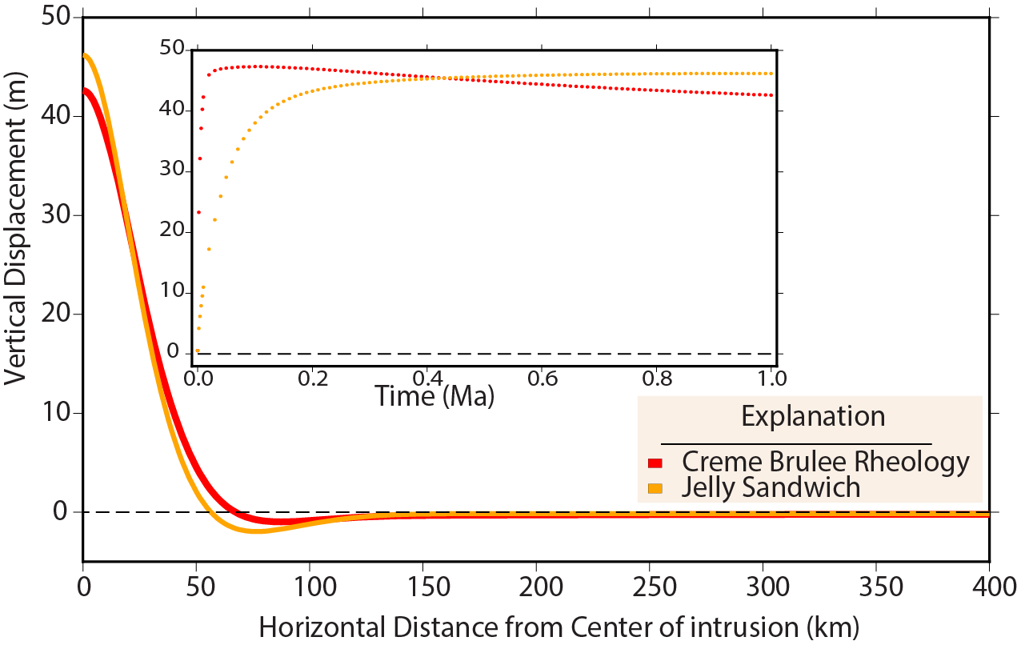
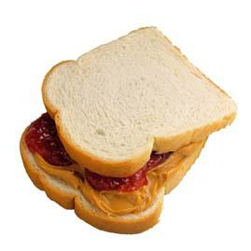
Rheology test: Créme Brûlée vs Jelly sandwich models
Two competing models for the structure of the lithosphere.
Créme Brûlée: A strong upper crust sits atop a weak lower crust and upper mantle
Jelly Sandwich: A weak lower crust is sandwiched between a mechanically strong upper crust and upper mantle.

Slide 12
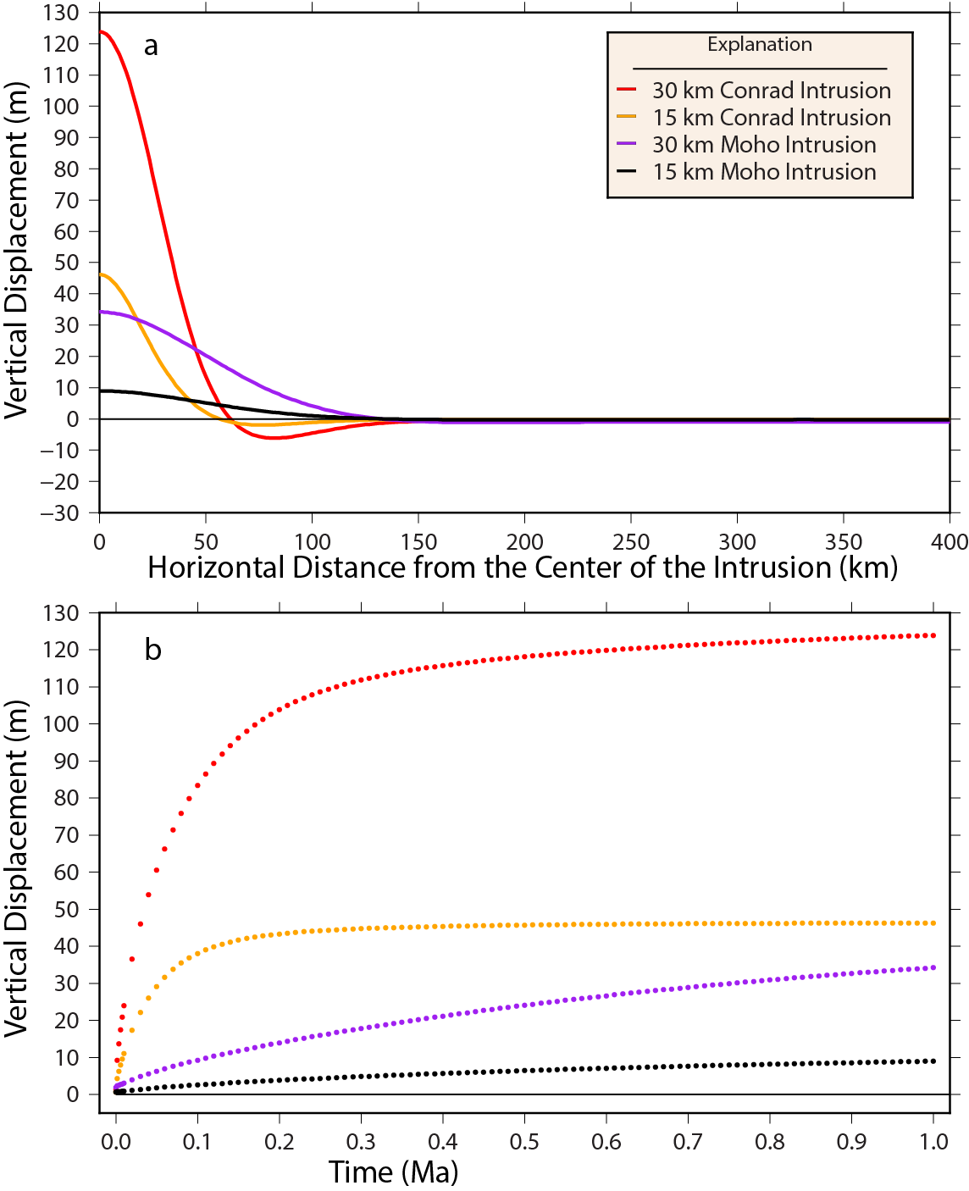
Varying Depth of the Intrusion
Hot zone model shows intrusion bodies at various levels in the lithosphere.
Density contrast hence buoyancy force will vary based on where the bodies are emplaced.

Slide 13
Model Validation
Comparison with Regional Gravity Observations

Slide 14
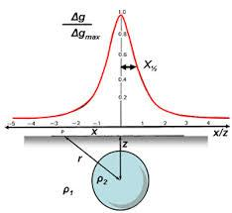
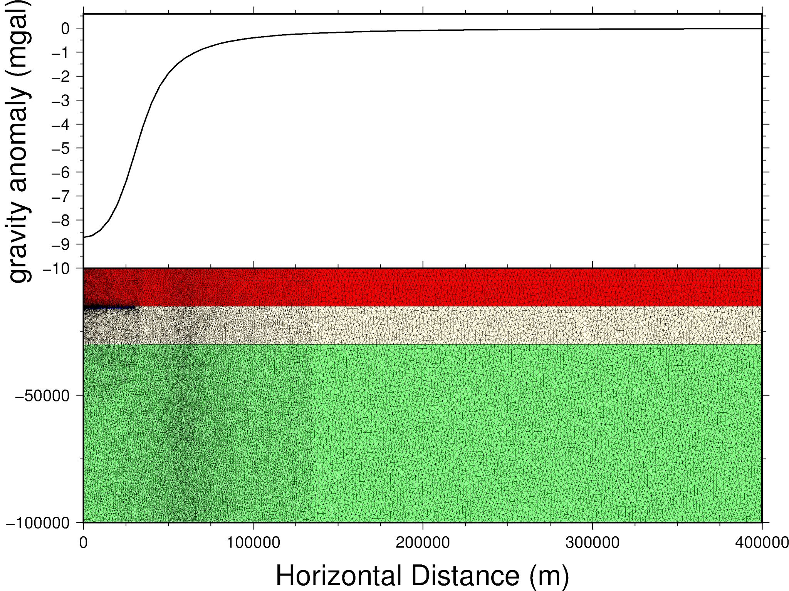
Gravity Anomalies
Lateral variations in density distributions will create anomalies in the gravitational attraction at the surface.
The wavelength and amplitude of the anomaly is strongly tied to the shape, burial depth and density of the body.
For each model, the gravitational attraction at the surface due to each triangular element within the domain was calculated at time step 0 and after 1 million years using an order 8 Gaussian Quadrature.
Jones, Francis H.M

Slide 15
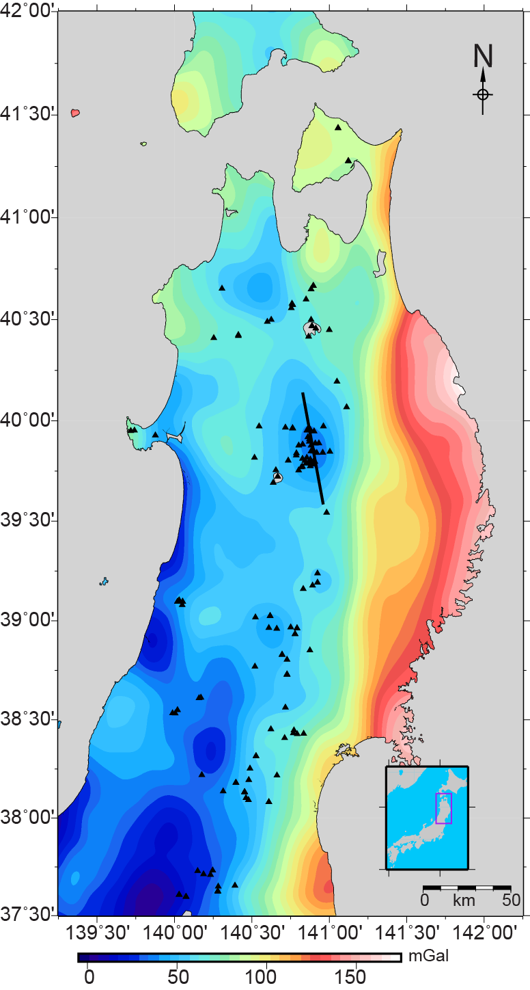
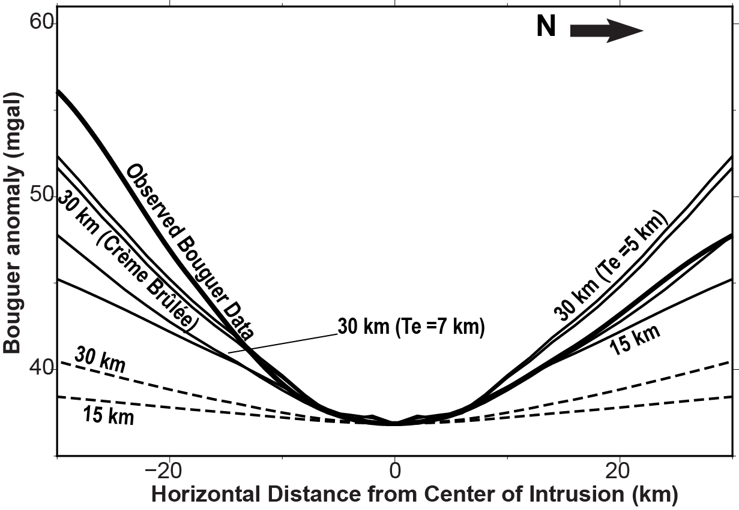
Best Fit Models
Bouguer Gravity anomalies for the models and the regional data

Slide 16
Conclusion
Magma underplating at both the Moho and Conrad provide sufficient force to uplift the surface by 10s of meters out to distances of 50 km or greater from the center of the intrusion.
In the Créme Brûlée rheological models, uplift is largely accommodated by flow within the lower crust and mantle while the Jelly Sandwich models rely strongly on mantle flow.
The data are best fit with 30 km underplating bodies.

Slide 17
References
Artemieva, I. M. (2011), Flexure and Rheology, vol. 1, book section 8, pp. 505–541, Cambridge University Press, New York.
Chen, W.-P., and P. Molnar (1983), Focal depths of intracontinental and intraplate earthquakes and their implications for the thermal and mechanical properties of the lithosphere, Journal of Geophysical Research: Solid Earth (1978–2012), 88 (B5), 4183–4214.
Chew, L. P. (1993), Guaranteed-quality mesh generation for curved surfaces, doi:10.1145/160985.161150.
Hasegawa, A., A. Yamamoto, D. Zhao, S. Hori, and S. Horiuchi (1993), Deep structure of arc volcanoes as inferred from seismic observations, Philosophical transactions: Royal Society London, 342, 167–178.
Jackson, J. (2002), Strength of the continental lithosphere: time to abandon the jelly sandwich?, GSA today, 12 (9), 4–9.
Jones, Francis H.M. Gravity Measurements. Earth and Ocean Sciences Science Education Initiative, n.d. Retrieved from http://www.eos.ubc.ca/~fjones/aglosite/objects/meth_4/basics.htm 19 Feb. 2015.
Ruppert, J. (1995), A Delaunay refinement algorithm for quality 2-dimensional mesh generation, Journal of Algorithms, 18 (3), 548–585.
Tamura, Y., Y. Tatsumi, Z. Dapeng, Y. Kido, and H. Shukuno (2001), Distribution of Quaternary volcanoes in the Northeast Japan arc: geologic and geophysical evidence of hot fingers in the mantle wedge, Proceedings of the Japan Academy. Series B Physical and biological sciences, 77 (7), 135–139.
Tamura, Y., Y. Tatsumi, D. Zhao, Y. Kido, and H. Shukuno (2002), Hot fingers in the mantle wedge: new insights into magma genesis in subduction zones, Earth and Planetary Science Letters, 197, 105–116.
Wilkinson, Jamie J. "Triggers for the formation of porphyry ore deposits in magmatic arcs." Nature Geoscience 6.11 (2013): 917-925.
"Buoyancy." Plato.is / Stability of Fishing Vessels / /. Westfjords Growth Agreement, n.d. Web. 19 Feb. 2015.

